Slide 1
COMMUNITY ACTION OF GREATER INDIANAPOLIS, INC.
2019
NEEDS ASSESSMENT
3266 N. Meridian Street, Indianapolis, IN 46208
317-396-1800
www.cagi-in.org

Slide 2
Table of Contents
CENSUS DATA
DEMOGRAPHIC MAPS
HOUSING UNITS REPORT
(2 - 3) CAGI Service Area
(4 - 7) CAGI Service Area Trends
(8 - 9) Boone County Snapshot
(10 - 11) Hamilton County Snapshot
(12) Hendricks County Snapshot
(13 - 15) Marion County Snapshot
(16) Tipton County Snapshot
(39 - 40) Housing Units in Structure
(41 - 42) Housing Units by Structure Built
(43 - 44) Renter Household Moved to Unit
(45 - 46) Owner Household Moved to Unit
(47 - 48) Occupied Housing Units
(49 - 50) Owner - Occupied Housing Units by Value
(19) Major Employers
(20) Crime Index
(21) Educational Attainment
(22) Change over HH 62+ years
(23) Median HH Income
(24) Population Growth
(25) Population Density
(26) Race Ethnicity Map
(27) Study Area Map
(28) Unemployment Map
HOUSEHOLD REPORT
(52 - 54) HH Presence of People < 18 years
(55 - 57) Family HH Presence of Own Children
(58 - 59) Group Quarters Population by Type
(60 - 61) Families by Poverty Status
(62) Population by Age & Sex
(63 - 64) Population by Age
(65) 2019 Population by Age
EMPLOYMENT REPORT
(30 - 31) Class of Worker
(32) Employed Population by Industry
(33 - 35) Employed Population by Occupation
(36 - 37) Top Employers
Community Action of Greater Indianapolis

Slide 3
Census Data
INCLUDES
• Service Area Demography
• Service Area Housing Trends
• Service Area Population Trends
• Service Area Household Trends
• Service Area Housing Trends
• County Snapshot Reports
1
Community Action of Greater Indianapolis

Slide 4
CAGI Service Area
1
2
Community Action of Greater Indianapolis

Slide 5
CAGI Service Area
3
Community Action of Greater Indianapolis

Slide 6
CAGI Service Area Trends
4
Community Action of Greater Indianapolis

Slide 7
CAGI Service Area Trends
5
Community Action of Greater Indianapolis

Slide 8
CAGI Service Area Trends
6
Community Action of Greater Indianapolis

Slide 9
CAGI Service Area Trends
7
Community Action of Greater Indianapolis

Slide 10
Boone County
8
Community Action of Greater Indianapolis

Slide 11
Boone County
9
Community Action of Greater Indianapolis

Slide 12
Hamilton County
10
Community Action of Greater Indianapolis

Slide 13
Hamilton County
11
Community Action of Greater Indianapolis

Slide 14
Hendricks County
12
Community Action of Greater Indianapolis

Slide 15
Hendricks County
Community Action of Greater Indianapolis
13

Slide 16
Marion County
14
Community Action of Greater Indianapolis

Slide 17
Marion County
Community Action of Greater Indianapolis
15
Community Action of Greater Indianapolis

Slide 18
Tipton County
16
Community Action of Greater Indianapolis

Slide 19
Tipton County
Community Action of Greater Indianapolis
17
Community Action of Greater Indianapolis

Slide 20
Demographic Maps
INCLUDES
Major Employers
Crime Index
Educational Attainment
HH AMI Change 65 years and Older
Median Household Income
Population Growth
Population Density
Race Ethnicity
Study Area
Unemployment
18
Community Action of Greater Indianapolis

Slide 21
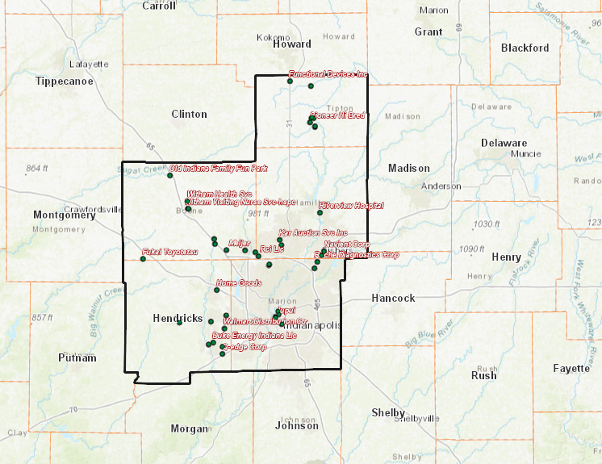
Major Employers
Community Action of Greater Indianapolis
19
Community Action of Greater Indianapolis

Slide 22
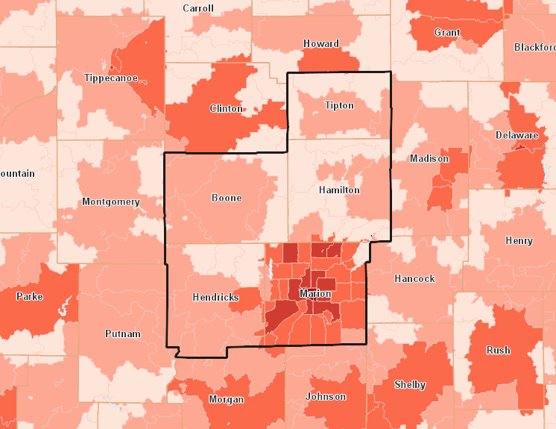
Crime Index
Community Action of Greater Indianapolis
20
Community Action of Greater Indianapolis

Slide 23
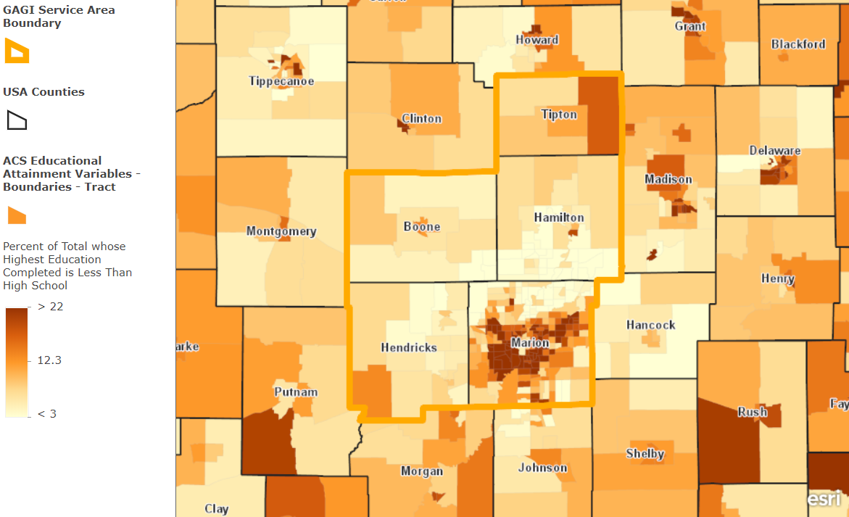
Educational Attainment
Community Action of Greater Indianapolis
21
Community Action of Greater Indianapolis

Slide 24
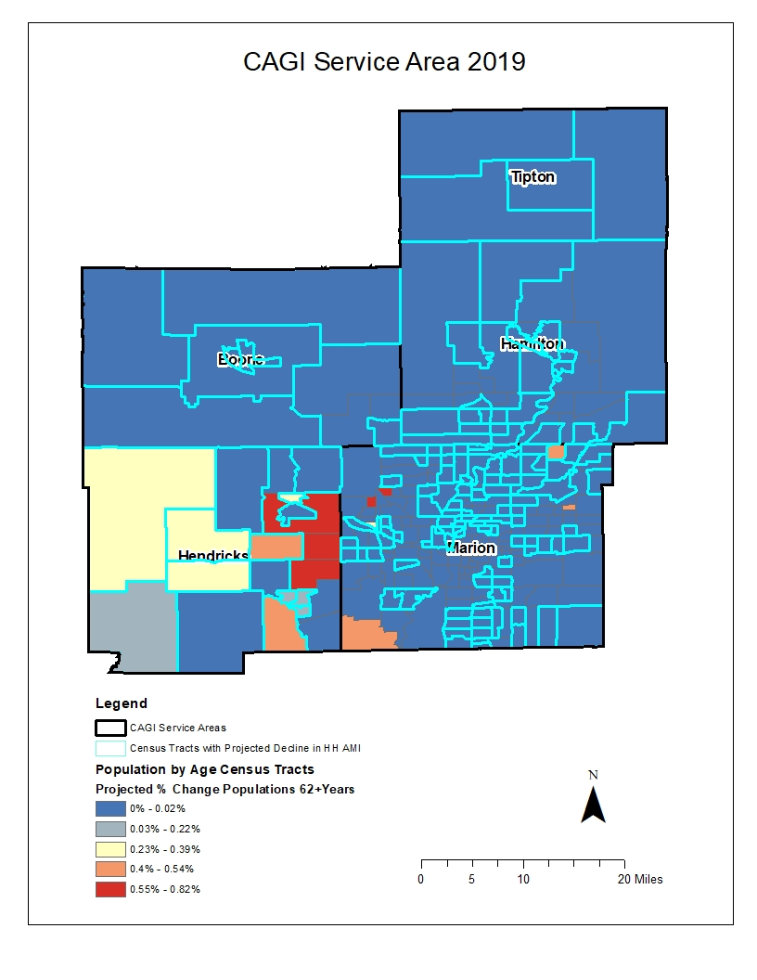
HH AM1 Change Over HH 62+ years
Community Action of Greater Indianapolis
22
Community Action of Greater Indianapolis

Slide 25
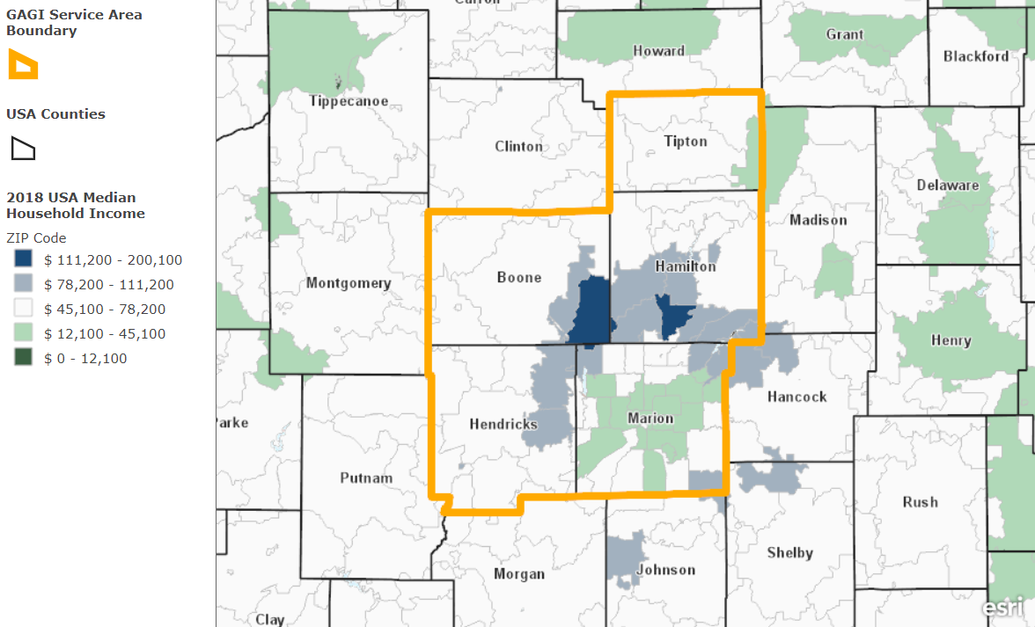
Median Household Incomes 2018
Community Action of Greater Indianapolis
23
Community Action of Greater Indianapolis

Slide 26
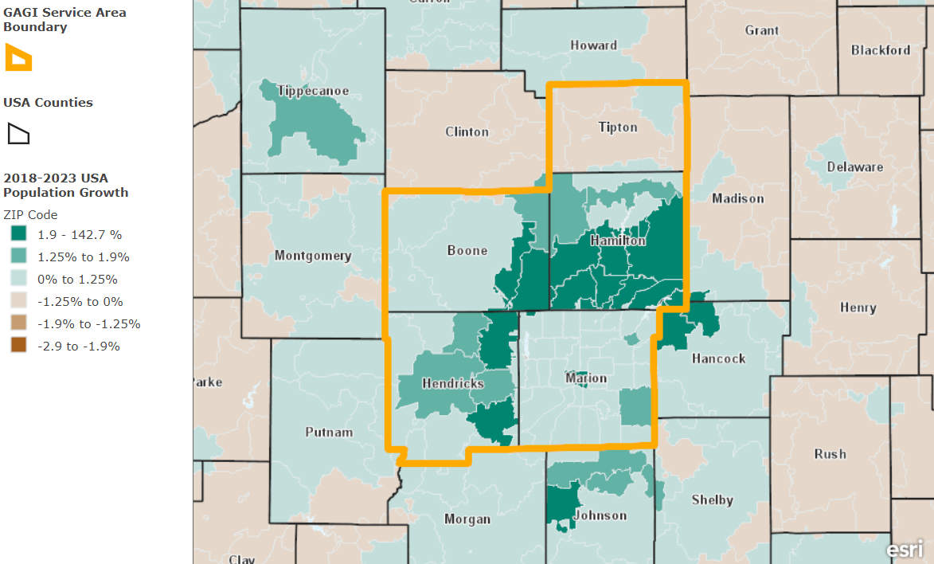
Population Growth
Community Action of Greater Indianapolis
24
Community Action of Greater Indianapolis

Slide 27
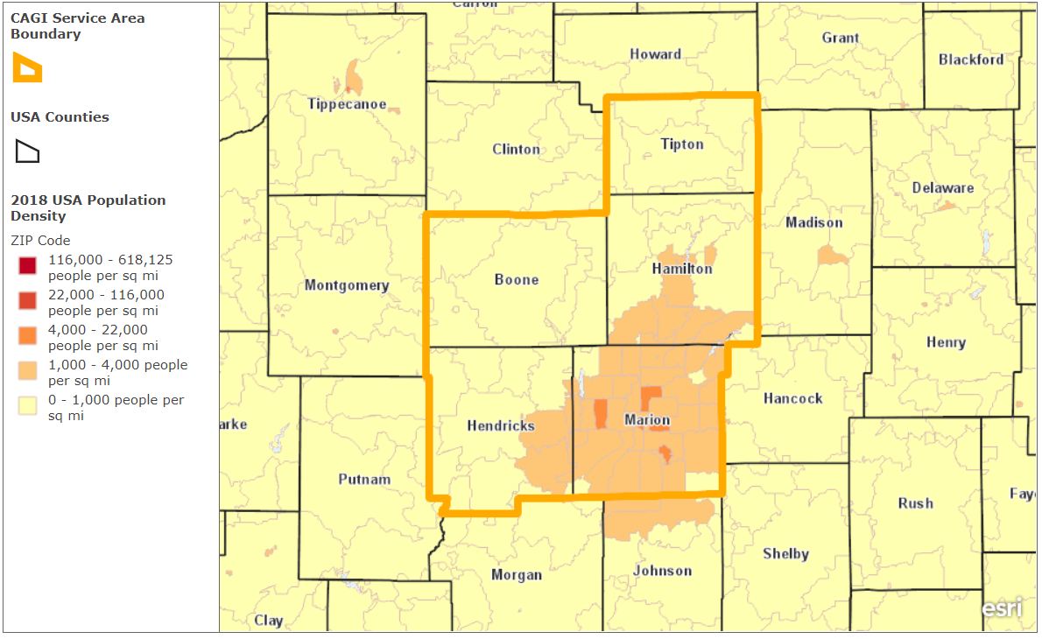
Population Density
Community Action of Greater Indianapolis
25
Community Action of Greater Indianapolis

Slide 28
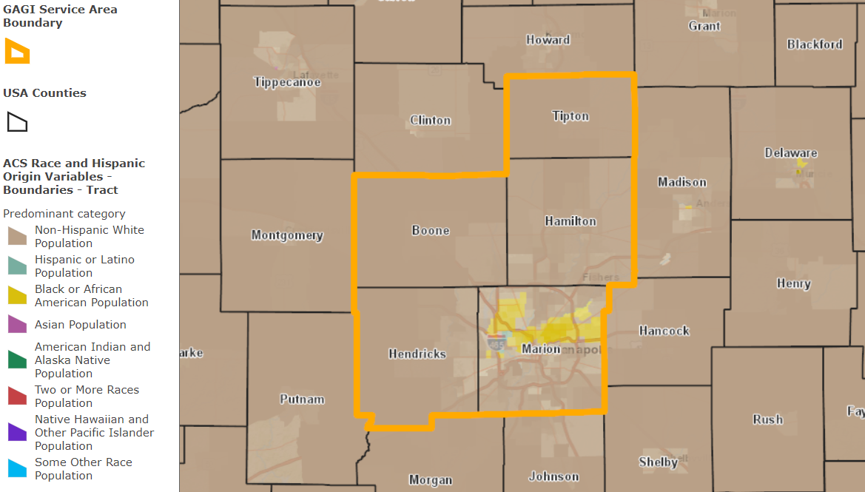
Race Ethnicity Map
Community Action of Greater Indianapolis
26
Community Action of Greater Indianapolis

Slide 29
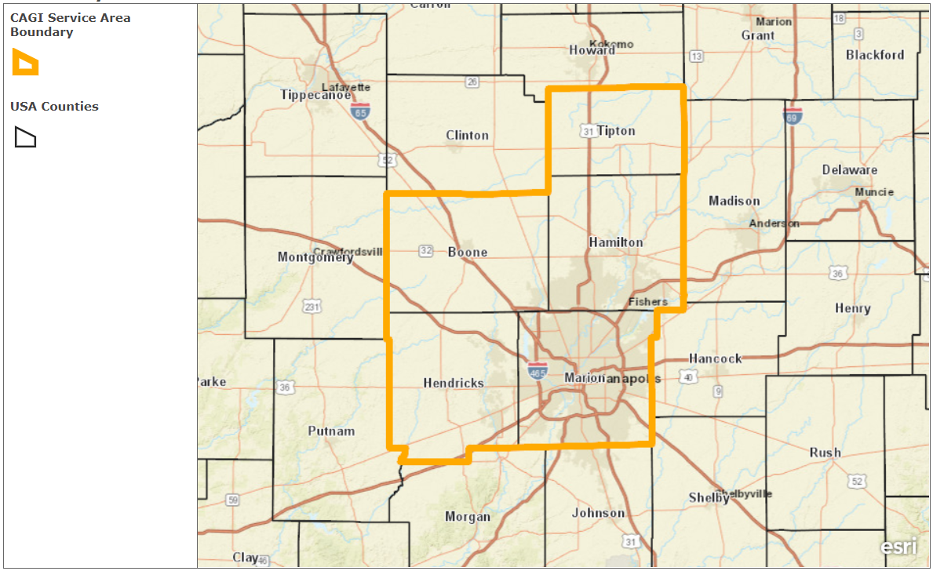
Study Area Map
Community Action of Greater Indianapolis
27
Community Action of Greater Indianapolis

Slide 30
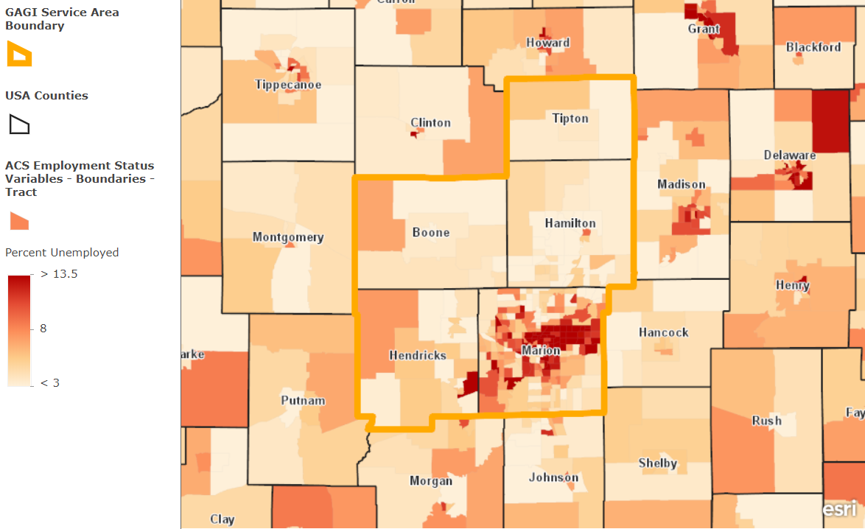
Unemployment Map
Community Action of Greater Indianapolis
28
Community Action of Greater Indianapolis

Slide 31
Employment Report
INCLUDES
• Class of Worker
• Employed Population by Industry
• Employed Population by Occupation
• Top Employers
29
Community Action of Greater Indianapolis

Slide 32
Class of Worker
Community Action of Greater Indianapolis
30
Community Action of Greater Indianapolis

Slide 33
Class of Worker
Community Action of Greater Indianapolis
31
Community Action of Greater Indianapolis

Slide 34
Employed Population by Industry
Community Action of Greater Indianapolis
32
Community Action of Greater Indianapolis

Slide 35
Employed Population by Occupation
Community Action of Greater Indianapolis
33
Community Action of Greater Indianapolis

Slide 36
Employed Population by Occupation
Community Action of Greater Indianapolis
34
Community Action of Greater Indianapolis

Slide 37
Employed Population by Occupation
35
Community Action of Greater Indianapolis

Slide 38
Top Employers
Employer
Industry
# Employees
Annual Sales
Amazon Fulfillment Center
Mail Order Fulfillment Service
2,500
-----------
Amazon, Inc.
Internet & Catalog Shopping
1,000
$397,379,000
Witham Hospital
Drug Detection Service & Equipment
800
$118,289,000
Witham Memorial Hospital
Hospitals
563
-----------
Witham Health Services
Physicians & Surgeons
500
$5,477,000
Witham Health Services
Home Health Service
300
$11,806,000
Meijer
Grocers - retailer
300
$55,058,000
Zionsville Meadows
Hospices
277
$21,444,000
Old Indiana Family Fun Park
Parks
275
-----------
36
Community Action of Greater Indianapolis

Slide 39
Top Employers
Employer
Industry
# Employees
Annual Sales
Jet Star, Inc.
Trucking
250
$46,136,000
Conseco Life Insurance
Insurance
4,001
-----------
Cno Financial Group, Inc.
Insurance Holding Companies
2,300
-----------
Bankers Conseco Life Ins.
Insurance
2,300
-----------
Rci, LLC
Vacation Time Sharing Plans
2,000
-----------
Navient Corp
Loans
1,700
$913,956,000
Riverview Health
Hospitals
1,500
$280,554,000
Washington National Ins.
Insurance
1,500
-----------
Riverview Hospital
Hospitals
1,013
-----------
37
Community Action of Greater Indianapolis

Slide 40
Housing Units Report
INCLUDES
• Housing units in Structure
• Housing Units by Year Structure Built
• Renter Household Moved to Unit
• Owner Household Moved to Unit
- Occupied Housing Units
- Owner - Occupied Housing Units by Value
38
Community Action of Greater Indianapolis

Slide 41
Housing Units in Structure
39
Community Action of Greater Indianapolis

Slide 42
Housing Units in Structure
40
Community Action of Greater Indianapolis

Slide 43
Housing Units by Year Structure Built
41
Community Action of Greater Indianapolis

Slide 44
Housing Units by Year Structure Built
42
Community Action of Greater Indianapolis

Slide 45
Renter Household Moved to Unit
43
Community Action of Greater Indianapolis

Slide 46
Renter Household Moved to Unit
44
Community Action of Greater Indianapolis

Slide 47
Owner Household Moved to Unit
45
Community Action of Greater Indianapolis

Slide 48
Owner Household Moved to Unit
46
Community Action of Greater Indianapolis

Slide 49
Occupied Housing Units
47
Community Action of Greater Indianapolis

Slide 50
Occupied Housing Units
48
Community Action of Greater Indianapolis

Slide 51
Owner - Occupied Housing Units by Value
49
Community Action of Greater Indianapolis

Slide 52
Owner - Occupied Housing Units by Value
50
Community Action of Greater Indianapolis

Slide 53
Household Report
INCLUDES
• Households by Presence of People < 18 years
• Family Households by Presence of Own Children
• Group Quarters Population by Type
• Families by Poverty Status
- Percent Population by Age and Sex
- 2019 Population by Age
51
Community Action of Greater Indianapolis

Slide 54
Households by Presence of People > 18 years
52
Community Action of Greater Indianapolis

Slide 55
Households by Presence of People > 18 years
53
Community Action of Greater Indianapolis

Slide 56
Households by Presence of People > 18 years
54
Community Action of Greater Indianapolis

Slide 57
Family Households by Presence of Own Children
55
Community Action of Greater Indianapolis

Slide 58
Family Households by Presence of Own Children
56
Community Action of Greater Indianapolis

Slide 59
Family Households by Presence of Own Children
57
Community Action of Greater Indianapolis

Slide 60
Group Quarters Population by Type
58
Community Action of Greater Indianapolis

Slide 61
Group Quarters Population by Type
59
Community Action of Greater Indianapolis

Slide 62
Families by Poverty Status
60
Community Action of Greater Indianapolis

Slide 63
Families by Poverty Status
61
Community Action of Greater Indianapolis

Slide 64
Population by Age and Sex
62
Community Action of Greater Indianapolis

Slide 65
Population by Age
63
Community Action of Greater Indianapolis

Slide 66
Population by Age
64
Community Action of Greater Indianapolis

Slide 67
2019 Population by Age
65
Community Action of Greater Indianapolis

Slide 68
Community Action of Geater Indianapolis

